Slide 1
Module II

Slide 2
MODELS OF PROFESSIONAL ROLES
Savior
Engineer assumes the role of someone who saves the society from all its evils.
Guardian
An engineer can play a crucial role in determining the needs of the society.

Slide 3
Bureaucratic Servant
the development of engineering solutions to the problems
Social Servant
In this role, the engineer looks up to the society as his master. He constantly listens to the aspirations of the society and acts to fulfill those needs.

Slide 4
Social Enabler and Catalyst
he assists the management to make informed decisions based on the best interests of the society.
Game Player
These engineers do not see themselves as masters or servants. They are motivated by the economic and technological challenges at any given time.

Slide 5
SELF INTEREST
Engineers are human beings with desires and ambitions and they are also tempted to act according to their own interest.
A healthy amount of self interest is essential for survival but if it increases, professional ego will be the result.

Slide 6
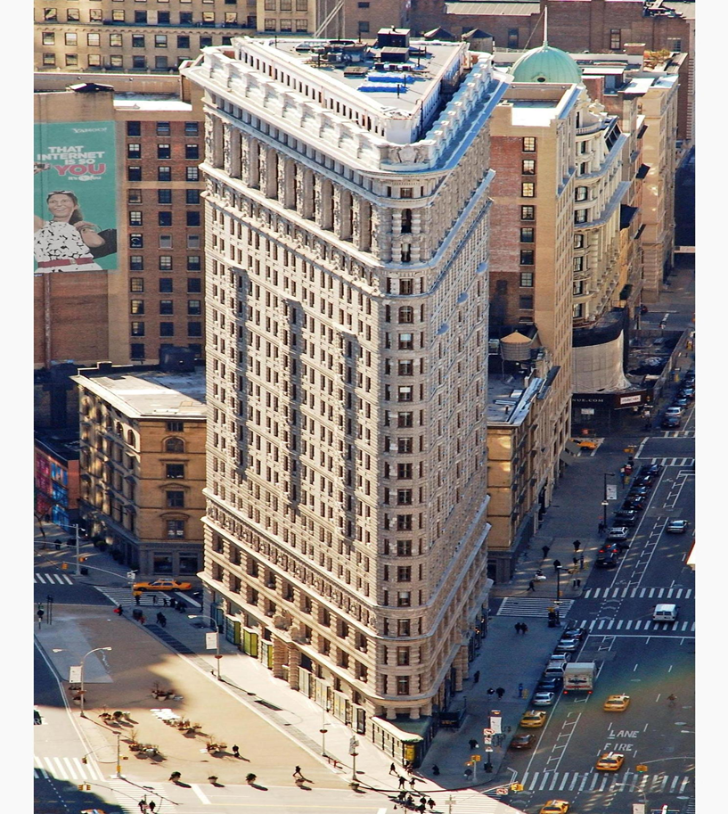
ENGINEERING AS SOCIAL EXPERIMENTATION

Slide 7

ENGINEERING AS SOCIAL EXPERIMENTATION
the development of a society and nation can be easily assessed by the technical advancement.
Engineers are responsible for the development in this regard.

Slide 8
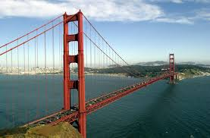
While developing the technology, an engineer should fore see the impact on the following:
The end user
The social fabric in terms of relationships, work, cultural exchange, etc.
The health of people in the long run.
The distribution of wealth

Slide 9
Similarities
engineering as experimentation and
Standard Experiments
One cannot be sure about all the outcomes of both the cases
Gaining of knowledge by constant monitoring is crucial to both

Slide 10
Differences
engineering as experimentation
Standard Experiments
No such groups
the people must be informed and no consent is required.
control group and experimental group
consent of the human subject is mandatory

Slide 11
ENGINEERS AS RESPONSIBLE EXPERIMENTERS
Conscientiousness
means commitment to live according to certain values.
. Comprehensive Perspective
getting the big picture and fully understanding the moral context of one’s work.
Moral Autonomy
ability to think critically and independently about moral issues

Slide 12
Accountability
It is the moral obligation of the engineer to account for his actions, decisions and responsibilities.

Slide 13
CODES OF ETHICS
Some of the features common to most of these codes are given below.
Protection of public safety, health and welfare
Actively discouraging bribery and plagiarism
Practicing no discrimination
Dissemination of clear and correct information ✓ Protecting confidentiality of employer ✓ Maintaining dignity

Slide 14
Advantages
Set out the ideals and responsibilities of the profession.
Exert a de facto regulatory effect protecting both clients and professionals.
Improve the profile of the profession.
Motivate and inspire practitioners, by attempting to define their raison d’etre.
Provide guidance on acceptable conduct.
Raise awareness and consciousness of issues.
Improve quality and consistency.

Slide 15
BALANCED OUTLOOK ON LAW
Absence or too much legislation will result in chaos and the growth of technology will be retarded. So law makers and engineers should resort to maintaining the balance in enforcement of legislation and laws

